Slide 1
Pasco County, Florida Outreach and Public Notices
Marcy Esbjerg
Community Development Director
Hilary Bruno
Community Development
Manager
NCDA Annual Conference
June 13, 2023

Slide 2
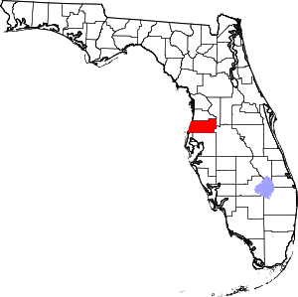
About Pasco County, FL
Population – 553,000 (just under 200,000 households)
Location – north of Tampa, FL on the Gulf of Mexico
Square Miles – 747
Owner-occupied/rental housing – 72/28%
LMI – 40% LMI, 54% Cost Burdened
CDBG - $3 million
HOME - $1.3 million
ESG - $255,000
CDBG-CV - $1.7 million/$1.99 million
ESG-CV - $834,000/$3.8 million

Slide 3
Mission Statement
Our mission at Community Development:
Improving the lives of Pasco’s citizens through homeless initiatives, neighborhood revitalization, affordable housing and community partnerships using state and federal funding.

Slide 4
THE WHY: Citizen Participation
24 Code of Federal Regulations, Part 91, Subpart B requires entitlement communities to adopt a Citizen Participation Plan to be used to encourage the involvement and consultation of citizens in the development, implementation and amendment to the ConPlan, Annual Action Plan and CAPER.

Slide 5
The Dot Survey:
Affordable Housing
Homelessness
Food Insecurity
Mental Health Needs
Senior Services
Transportation Needs
Veteran Services
Emergency Shelters for Homeless
Substance Abuse Needs

Slide 6
Where did we go?
We “invited” ourselves to many different meetings across the county.
COC Meeting
Community Impact Council Meeting
HUB Task Force
Neighborhood Associations
Food Distribution Events
Commission on the Status of Women
And more!

Slide 7
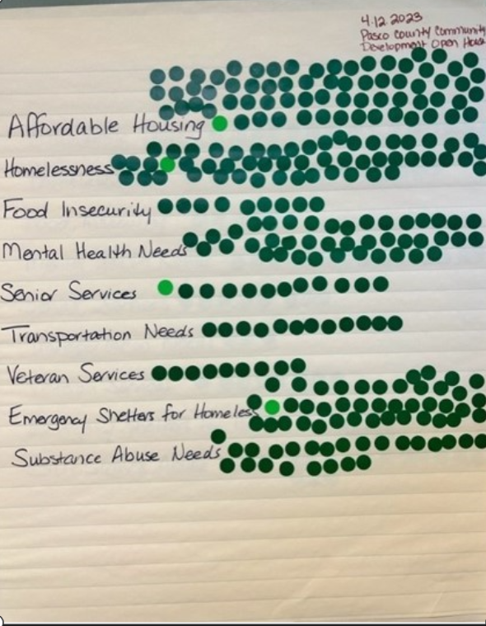
Results

Slide 8
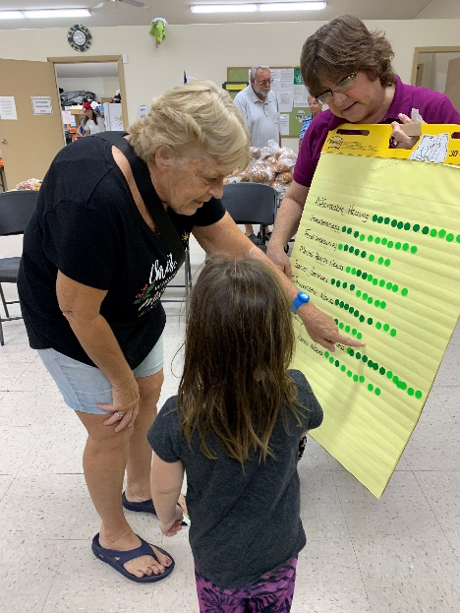

Slide 9
Survey Says:
Affordable Housing- 322.5
Homelessness- 204.5
Food Insecurity- 98.5
Mental Health Needs- 209.5
Senior Services- 102.5
Transportation Needs- 85
Veterans Services- 132.5
Emergency Shelters for Homeless- 192.5
Substance Abuse Needs- 167.5

Slide 10
LESSONS LEARNED
Don’t schedule a meeting - invite yourself to a meeting that is already scheduled
Information gathered is useful information and kept review committees focused
People are ingenious – note the half stickers
Have fun – this is a great opportunity to educate people

Slide 11
Public Notice – tips and tricks for staying on track
“Reverse math”
What date does your report need to be submitted to HUD?
What date will governing board approve?
When will comment period end? (15 days CAPER/30 days all other)?
When does the ad need to be published?
11/10 Technical Assistance to agencies
12/2 CAPER ad submitted to TBT
12/7 CAPER ad published
12/9 Review Committee Brainstorming
CAPER draft posted to website
12/28 CAPER due to HUD
1/6 Invite Review Committee
1/27 Grant kick off ad submitted to TBT
2/1 Grant kick off ad published
3/3 Review Committee Orientation
3/9 Grant Kick off
3/10 Grant Kick off
Applications go live
3/17 All questions must be submitted
3/20 send out all questions
3/30 Applications due – 4pm
4/3 Review apps for minimum standards
4/4 Notify agencies if application is not moving forward
Forward applications to compliance
Schedule visits with Jim’s team
4/12 Review Committee meeting posted on county calendar and our website
Review Committee meeting sign on our bulletin board
4/14 Release applications to review committee
5/2 CDBG Review Committee
5/3 ESG/HOME review Committee
5/26 ConPlan ad to TBT
5/31 ConPlan ad published in TBT
6/21 Public Hearing for ConPlan
7/3 ConPlan posted
Public Comment period (30 days) begins
8/4 Public Comment period ends
8/8 ConPlan to BCC
8/15 ConPlan due to HUD

Slide 12
Contact Information:
Hilary Bruno
Pasco County Community Development
hbruno@pascocountyfl.net
727-834-3447

